Slide 1

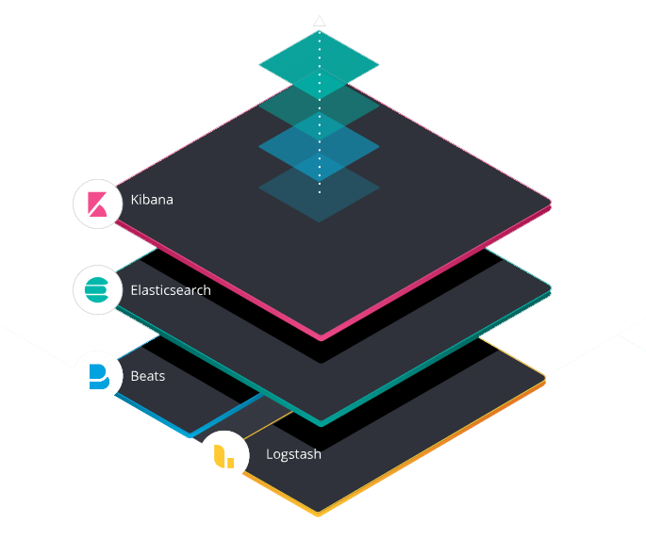
Ci/cd AND ELK STACK
Goncharov Victor
EPAM 2019

Slide 2
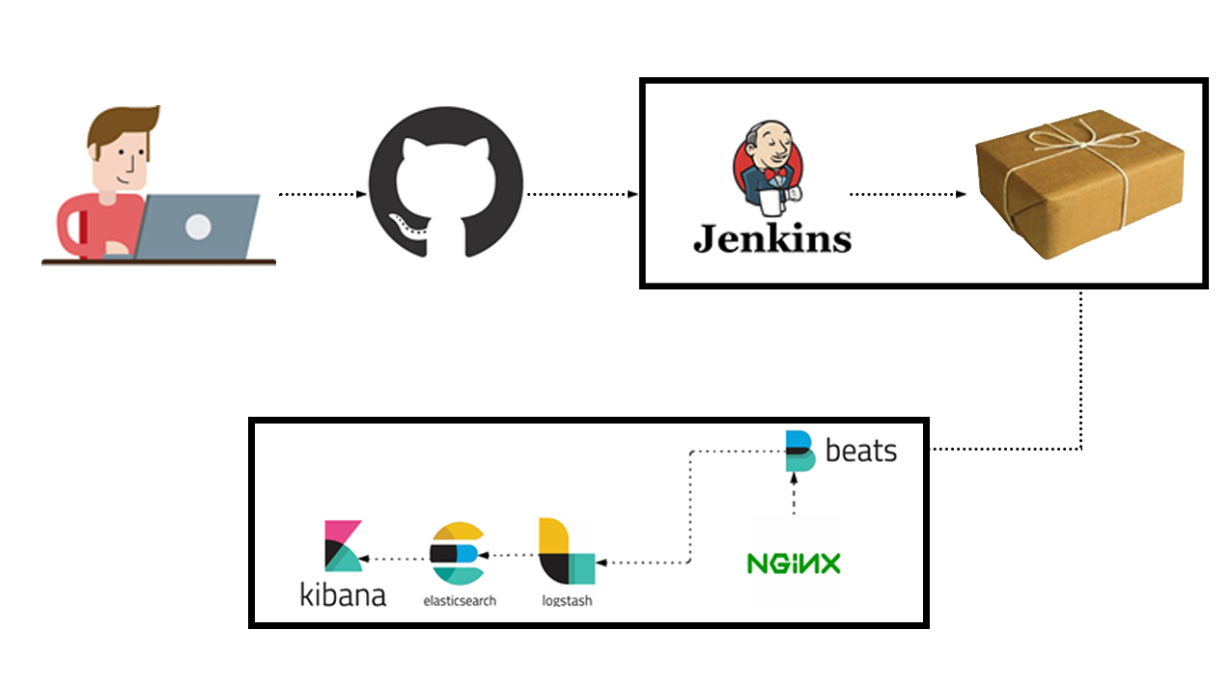
pROJECT
192.168.200.101
192.168.200.102

Slide 3









Project tools

Slide 4
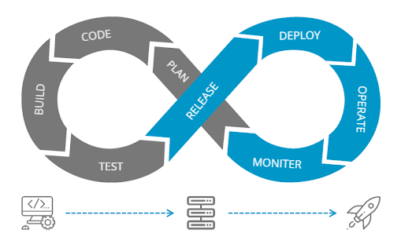
What is CI/CD?
Continuous integration focuses on integrating work from individual developers into a main repository multiple times a day to catch integration bugs early and accelerate collaborative development.
Continuous delivery is concerned with reducing friction in the deployment or release process, automating the steps required to deploy a build so that code can be released safely at any time.
Continuous deployment takes this one step further by automatically deploying each time a code change is made.

Slide 5
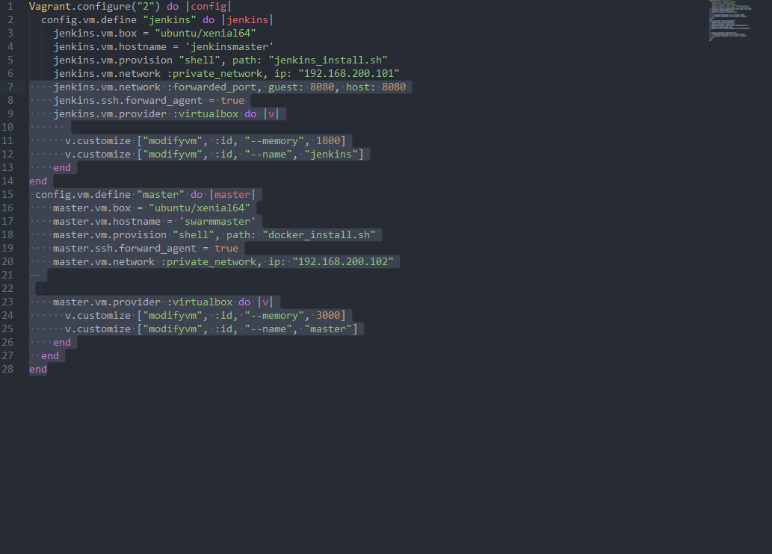
vagrant up machines
localhost
vagrant init
vagrant up
jenkins
master
192.168.200.101
192.168.200.102

Slide 6

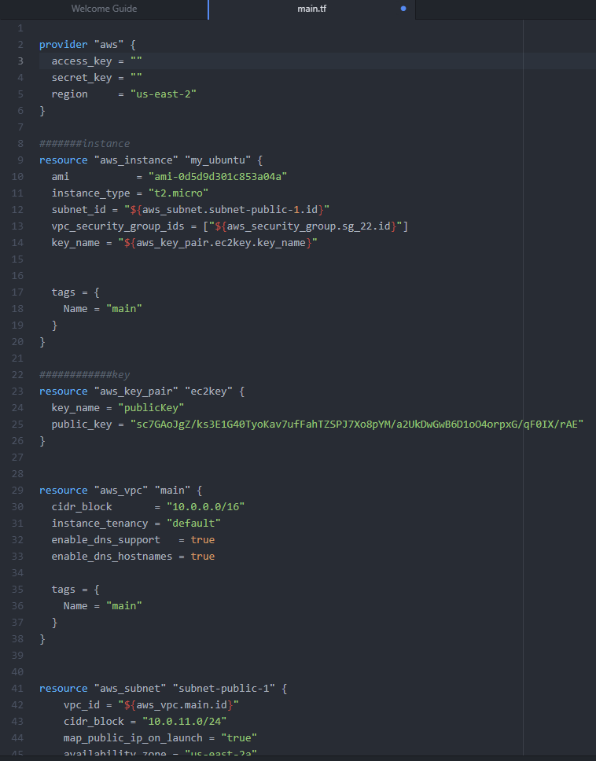
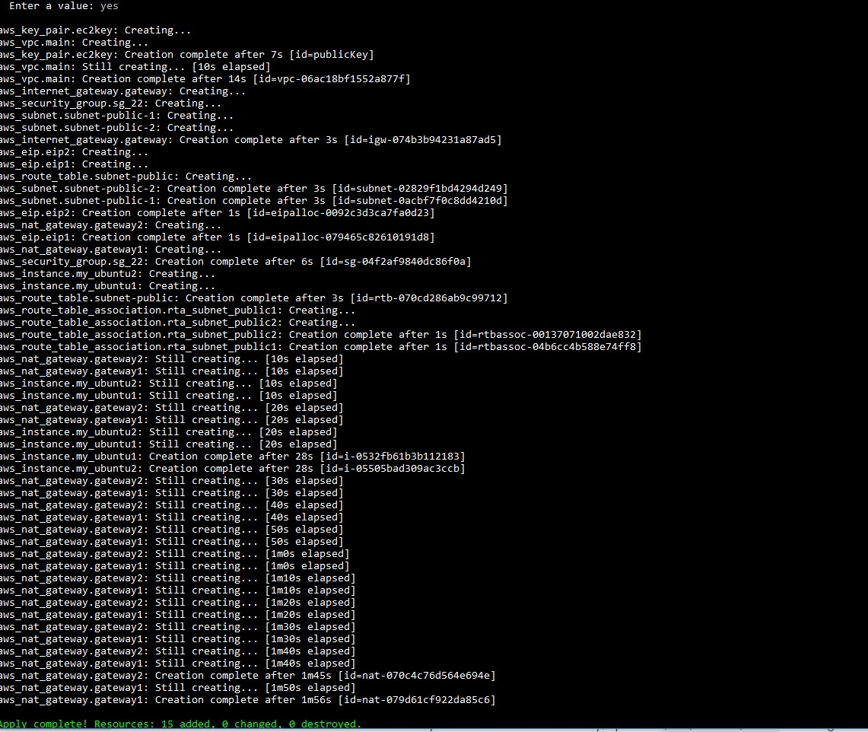
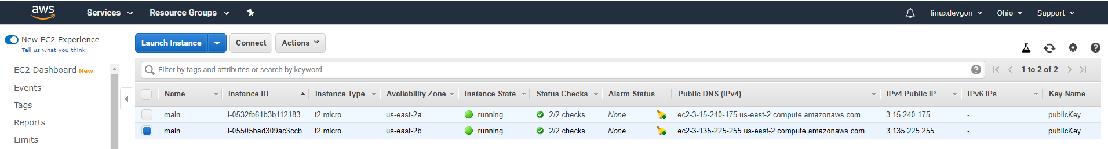
Terraform

Slide 7
Subnet 1
Instance
Nat gateway 1
VPC
Router
Internet Gateway
Subnet 2
Inet
Instance
Nat Gateway 2

Slide 8






remote server
Jenkins in local computer and connect to remote server
192.168.200.101
192.168.200.102
key
ssh
User jenkins
User root

Slide 9
Automatically triggering a Jenkins build on Git commit
Connect scm with ci/cd
push
changes come immediately
2. need an entry point to ci/cd from csm
pull
checks for scheduled changes
ci/cd may not have any entry points to csm

Slide 10

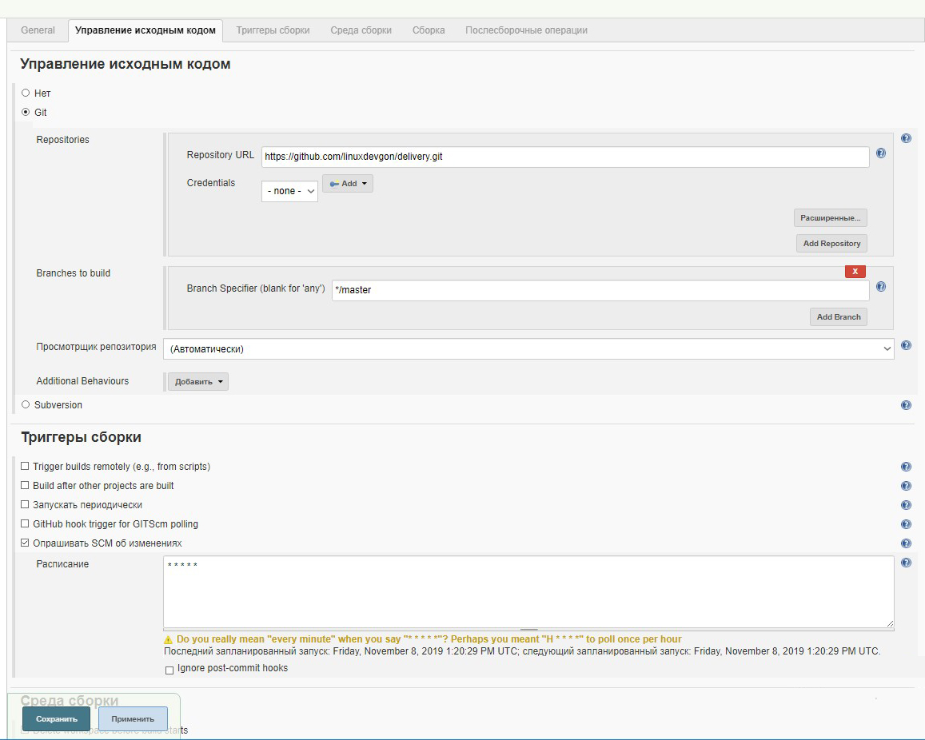
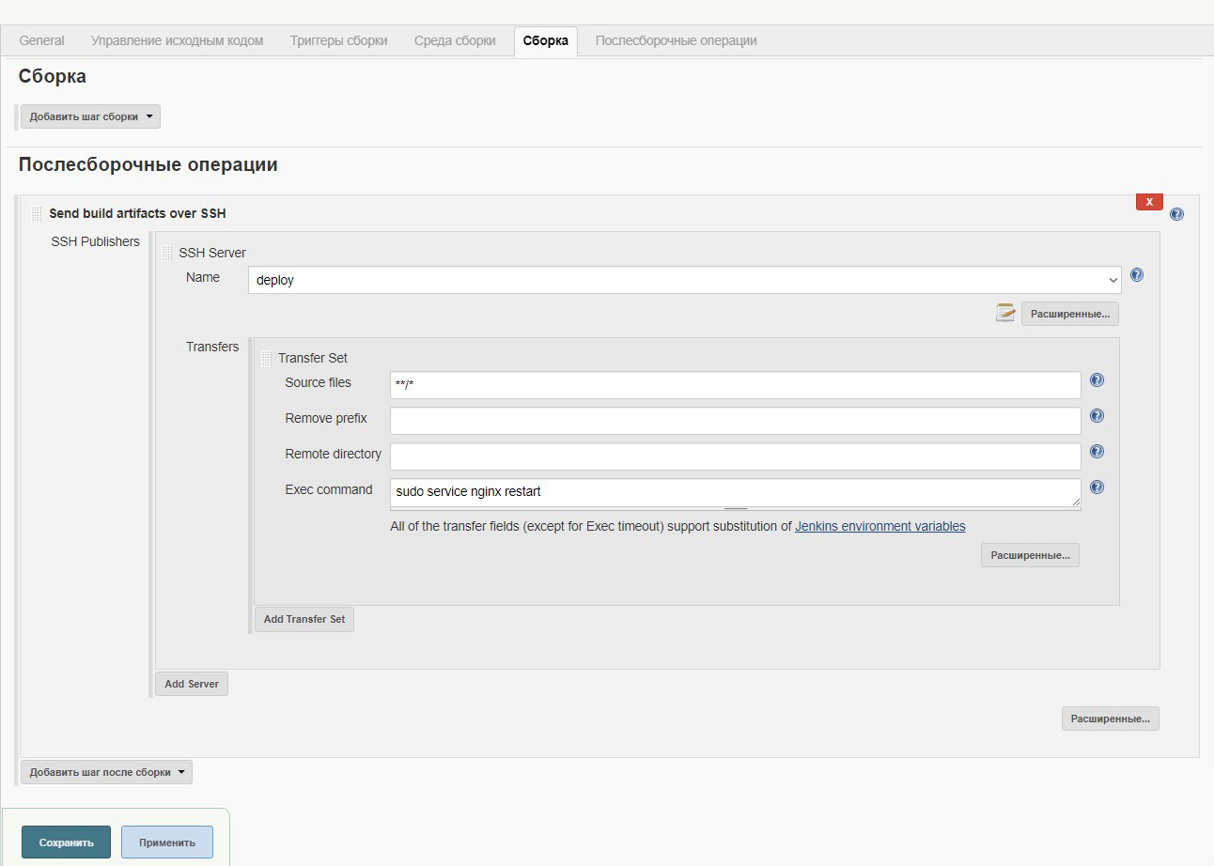
pipeline customization
pipeline with build customization by commit
Publish over ssh plagin

Slide 11
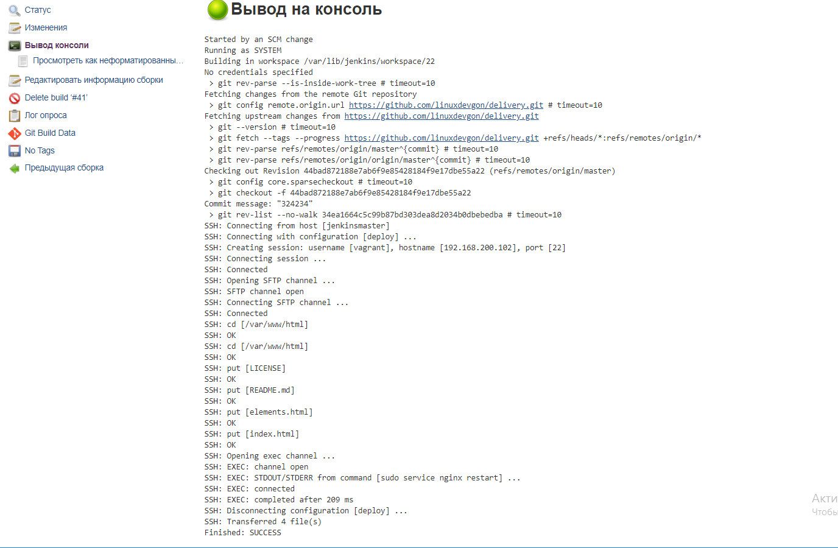


what's problem with you?
output
website
192.168.200.101
192.168.200.102
jenkins
master

Slide 12
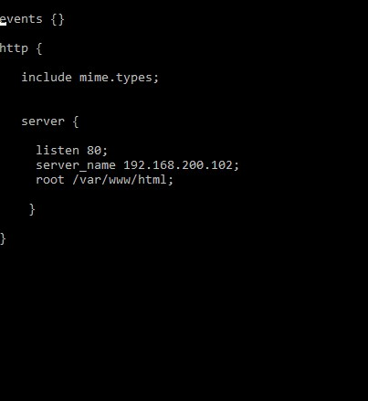
solution
Nginx config
Publish over ssh plagin

Slide 13

result

Slide 14
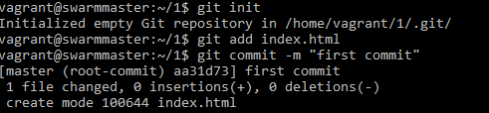
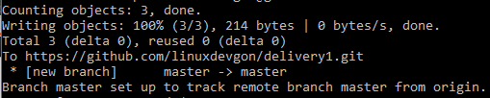
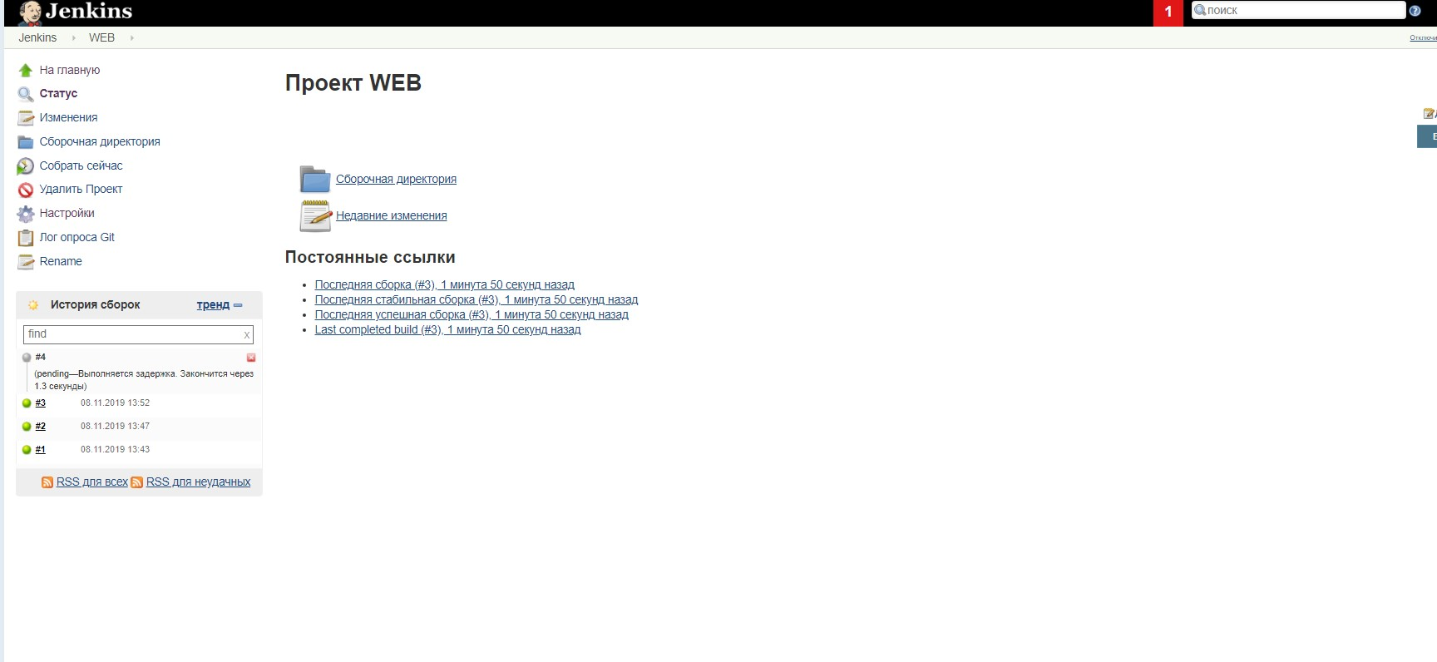

commit work
Before commit
after commit

Slide 15
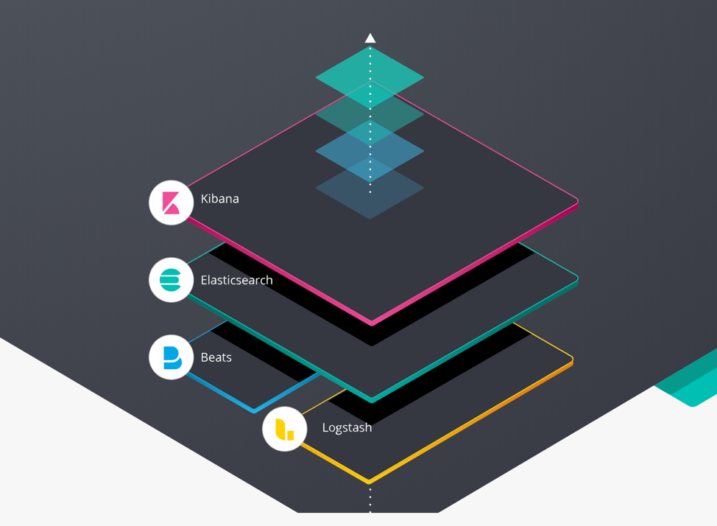
Elk stack
the ELK Stack is the world’s most popular log management platform
Beats are lightweight agents that are installed on edge hosts to collect different types of data for forwarding into the stack
Elasticsearch is an open source, full-text search and analysis engine, based on the Apache Lucene search engine
Logstash is a log aggregator that collects data from various input sources, executes different transformations and enhancements and then ships the data to various supported output destinations
Kibana is a visualization layer that works on top of Elasticsearch, providing users with the ability to analyze and visualize the data

Slide 16
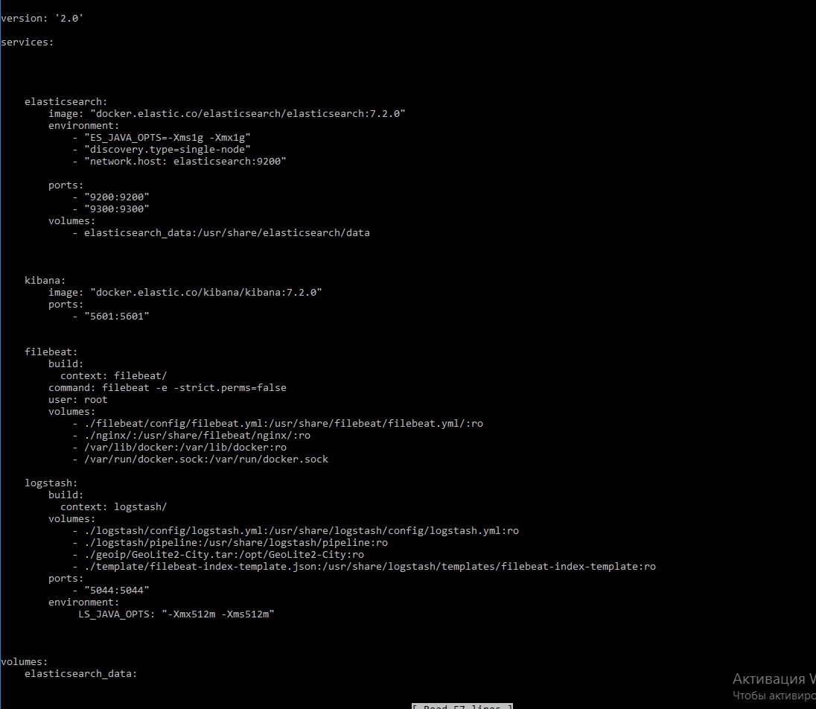

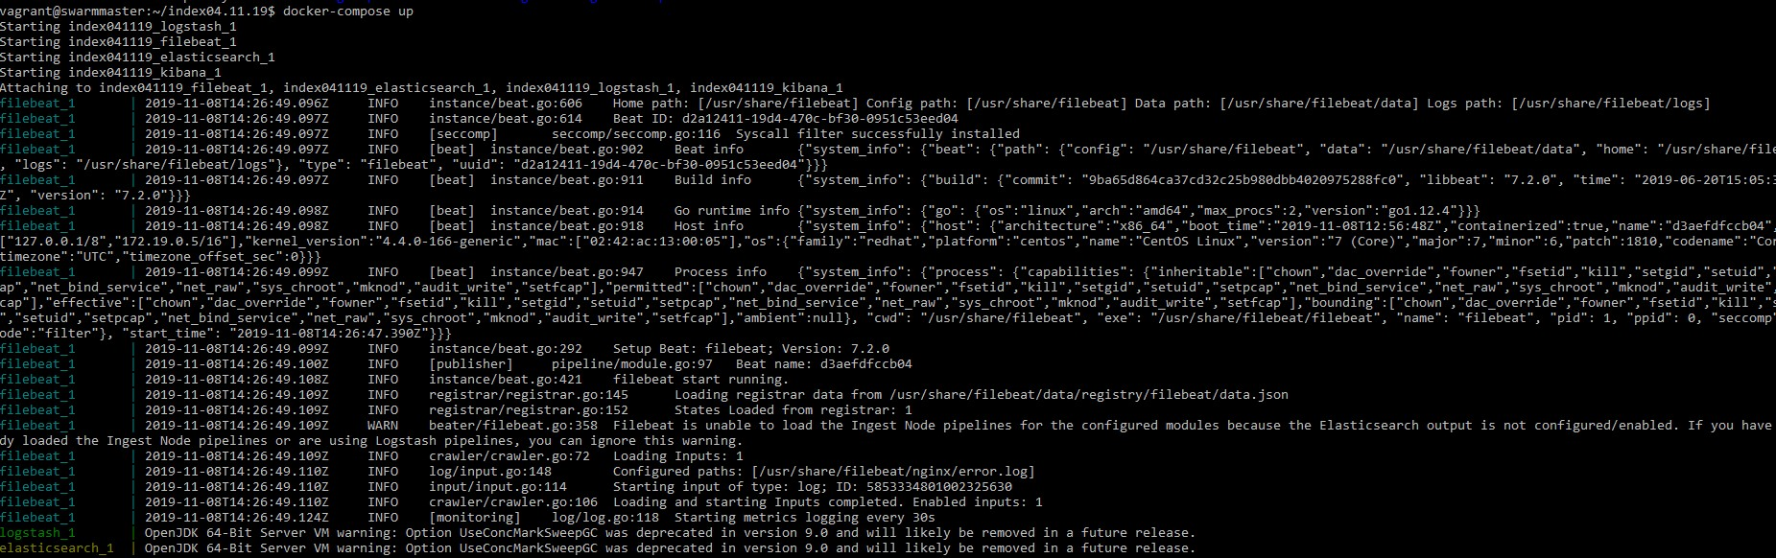
Docker + elk stack
docker containers run

Slide 17
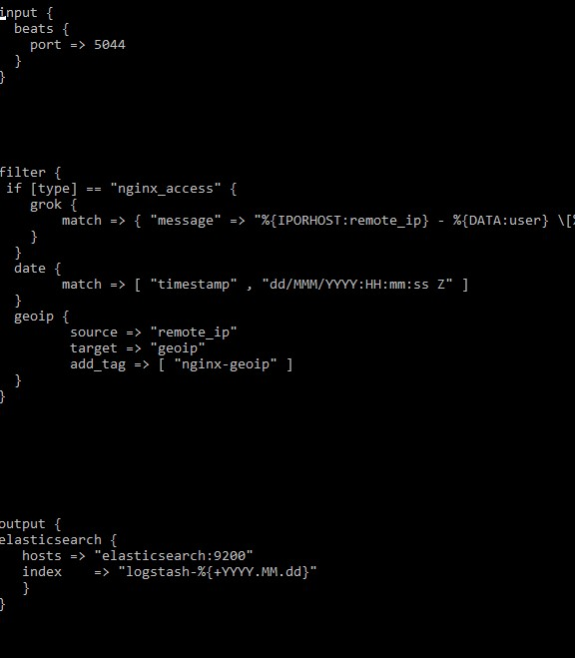
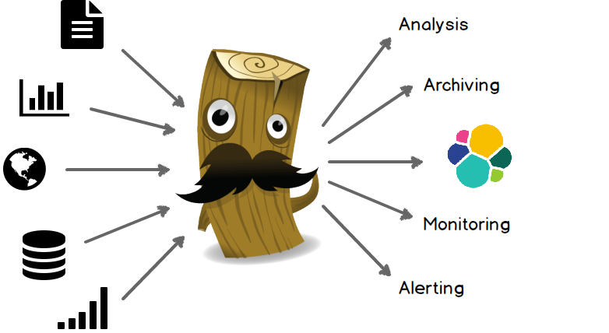
Logstash config

Slide 18
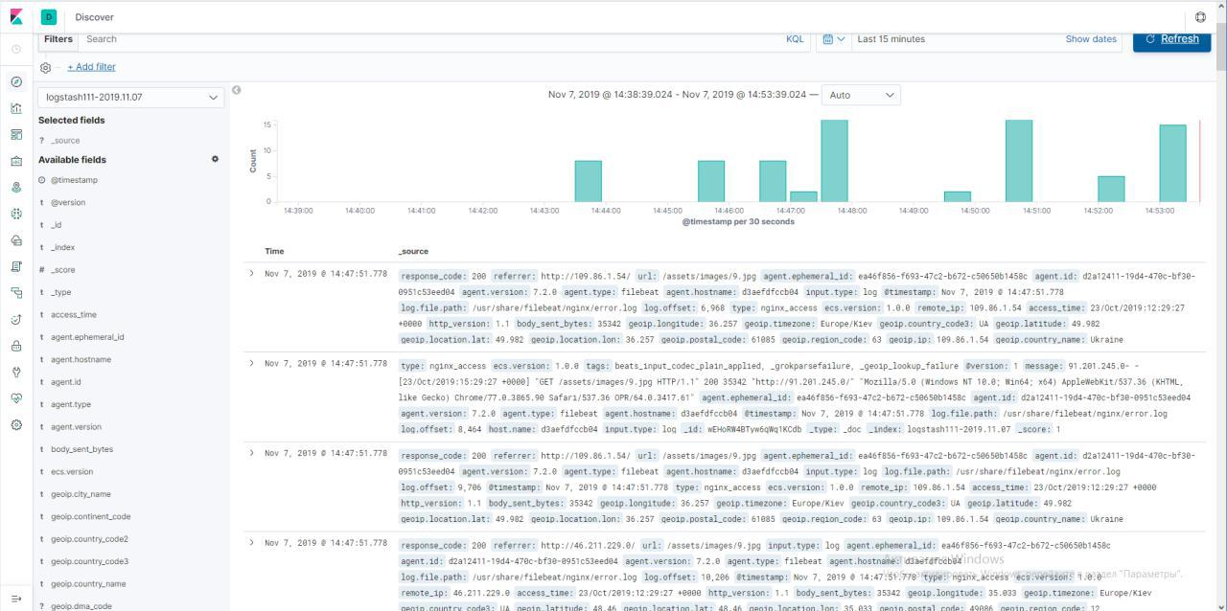
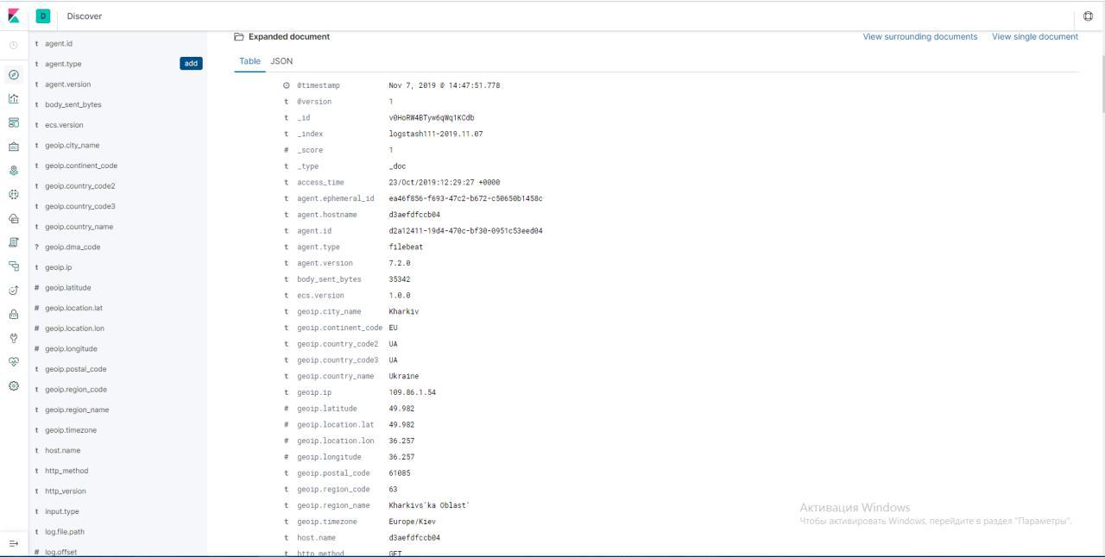
logs in the kibana

Slide 19
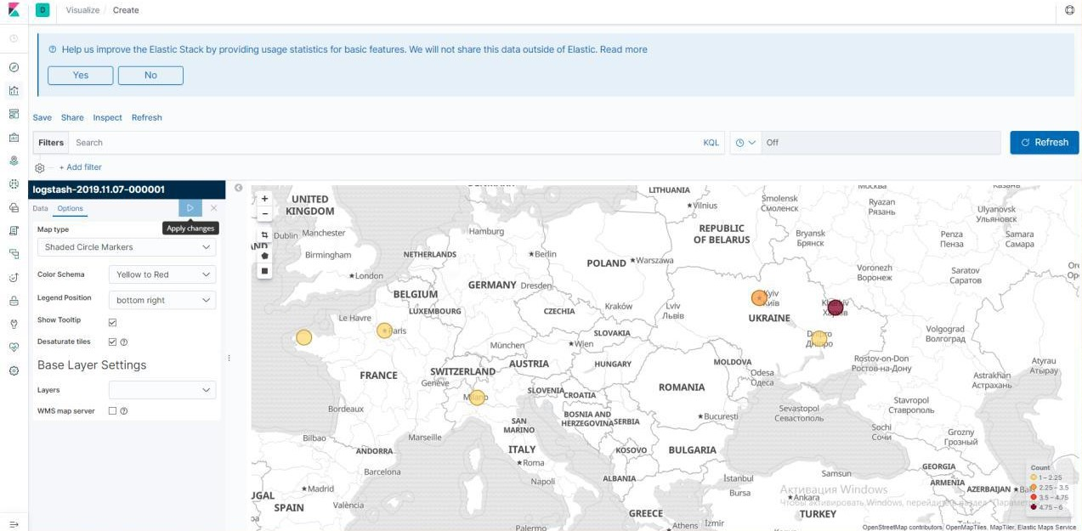
Map User Location with GeoIP and ELK

Slide 20
The end!
thank for your attention!

